Slide 1
Systems thinking & Tourism
Lecture 2

Slide 2
If sustainable tourism is about relationships it makes sense to think about it in terms of systems

Slide 3

Systems thinking

Slide 4
Loopy thinking!
Not new (e.g. myths, sagas, legends, parables)
Complex vs complicated or simple
Non-linear vs linear (one cause -> one effect)
Emergent vs predictable, mechanistic, determined

Slide 5
One definition
Donella Meadows describes systems as:
“a set of things interconnected in such a way that they produce their own pattern of behaviour over time. The system may be buffeted, constricted, triggered, or driven by outside forces. But the system’s response to these is characteristic of itself and that response is seldom simple in the real world”
(Meadows, 2009, p.2)

Slide 6
7 characteristics (Sterman, 2010)
Non-linear 
Dynamic
Tourism Systems
 Governed by feedback 
Tightly coupled 
Self-organising 
Adaptive  Evolving

Slide 7
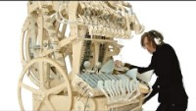

Compare complicated & complex

Slide 8
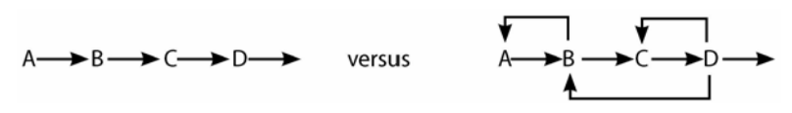
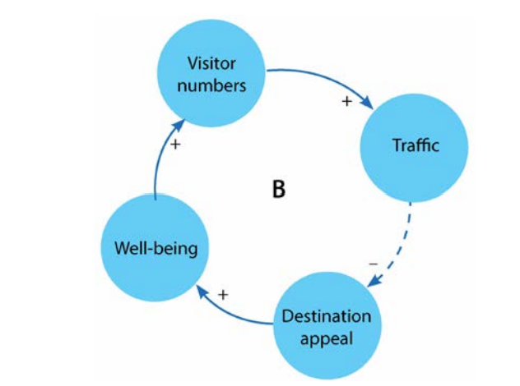
Feedback (the loops) in systems
Linear
Non-linear
Note that feedback loops can be balancing or reinforcing.
If reinforcing, they will either make the system get “better and better” (virtuous) or “worse and worse (vicious)

Slide 9
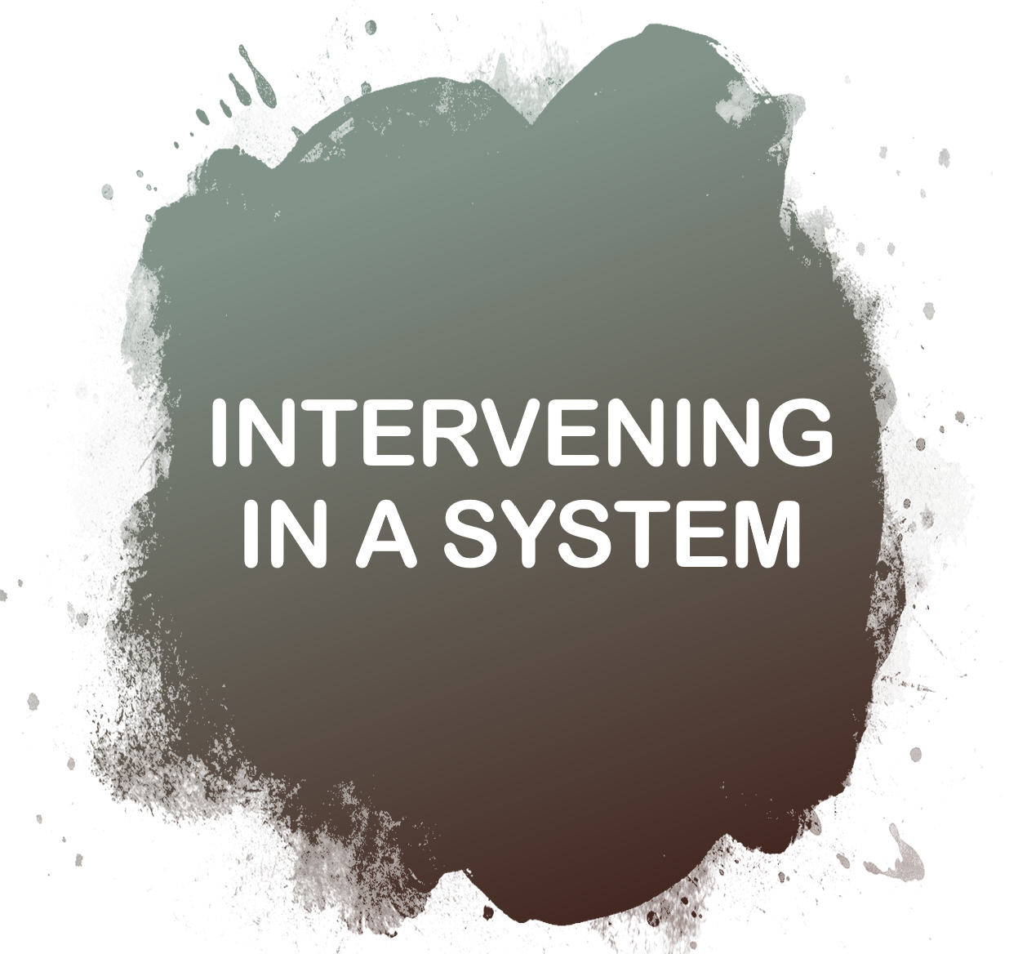

Slide 10
Meadows’ intervention points
Intervening to redirect a system
Simplest but
least effective
12. Constants, parameters, numbers (such as subsidies, taxes, standards).
11. The sizes of buffers and other stabilizing stocks, relative to their flows.
10. The structure of material stocks and flows (e.g. transport networks,
population age structures).
9. The lengths of delays, relative to the rate of system change.
8. The strength of negative feedback loops, relative to the impacts they
are trying to correct against.
7. The gain around driving positive feedback loops.
6. The structure of information flows (who does/doesn’t have access to info).
5. The rules of the system (such as incentives, punishments, constraints).
4. The power to add, change, evolve, or self-organize system structure.
3. The goals of the system.
2. The mindset or paradigm out of which the system — its goals, structure,
rules, delays, parameters — arises.
1. The power to transcend paradigms.
Most effective but very hard

Slide 11
Four types of intervention
Meadows’ places to intervene in a system can be grouped into four major types of intervention.
Parameters – you don’t fundamentally change the system, but you set some limits based on indicators, etc.
Feedback – you try to use the systems feedback systems to stop it from getting worse (focus on balancing feedback loops) or improve it (focus on virtuous feedback loops)
Design – you start redesigning the rules and goals of the system
Intent – you change the whole paradigm that the system emerges from (e.g. competition to cooperation, growth to steady state)

Slide 12
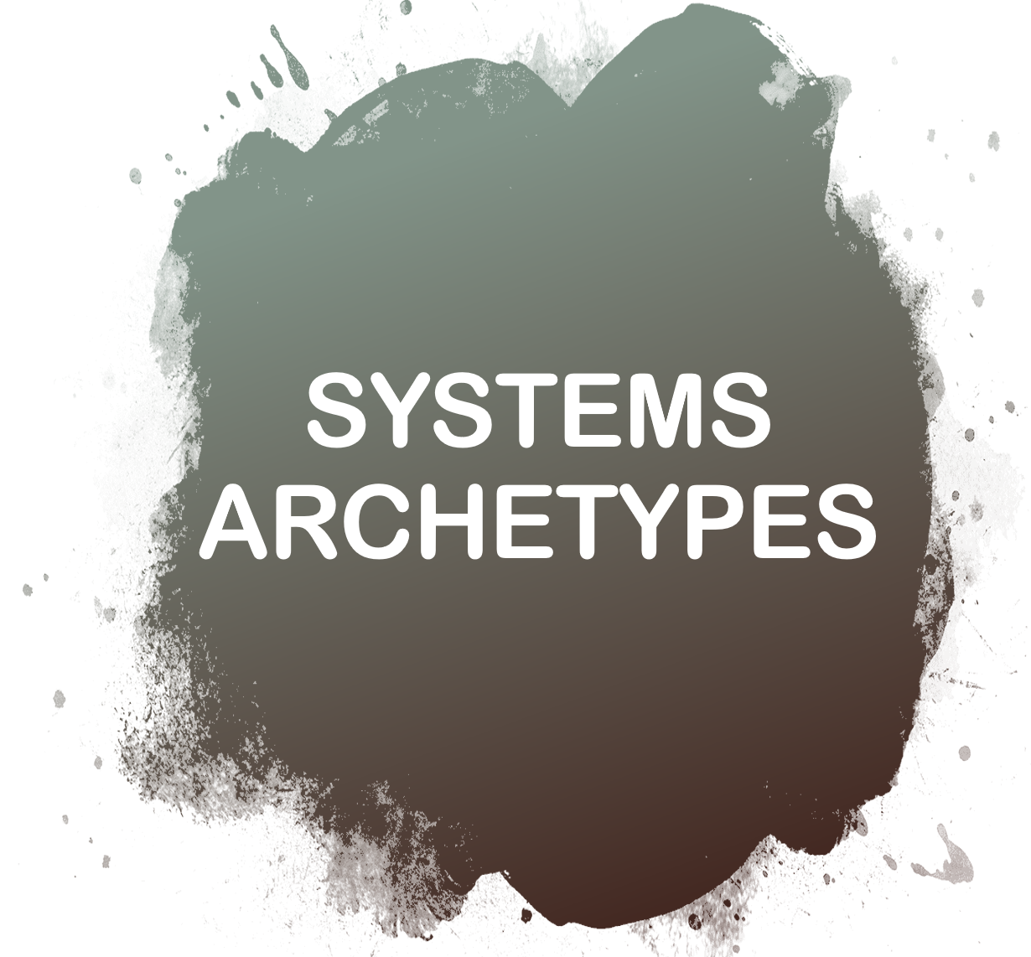

Slide 13
When systems don’t play nice…
Systems archetypes are patterns of behaviour in a system that allows us to understand them better and find the best places to intervene to change them

Slide 14
Types of archetypes
Tragedy of the commons
Success to the successful
Eroding goals
Fixes that fail
Seeking the wrong goal
Rule beating
Addition

Slide 15
One notable archetype – Tragedy of the Commons
Eleanor Ostrom and the story of four people named Everybody, Somebody, Anybody, and Nobody:
“There was an important job to be done and Everybody was sure that Somebody would do it. Anybody could have done it, but Nobody did it. Somebody got angry about that, because it was Everybody’s job. Everybody thought Anybody could do it, but Nobody realized that Everybody wouldn’t do it. It ended up that Everybody blamed Somebody when Nobody did what Anybody could have.”
The tragedy results from (or requires) three major features:
The resource is held in common
There is no reason for the individual to not maximise their own utility
At a certain point, the systems enters a feedback state characterised by a vicious cycle.
From a systems thinking perspective, the issues are NO DIRECT FEEDBACK TO THE INDIVIDUAL and DELAYS IN THE FEEDBACK on the overall condition of the system that mask the impact of decisions.
Solutions:
Educate and exhort the users of the commons to become responsible for their individual actions’ impact on the collective
Privatise the commons so that each person receives the feedback of their actions directly so that people harm only themselves and not the group.
Regulate the commons, enforced by policing and penalties.

Slide 16


Slide 17
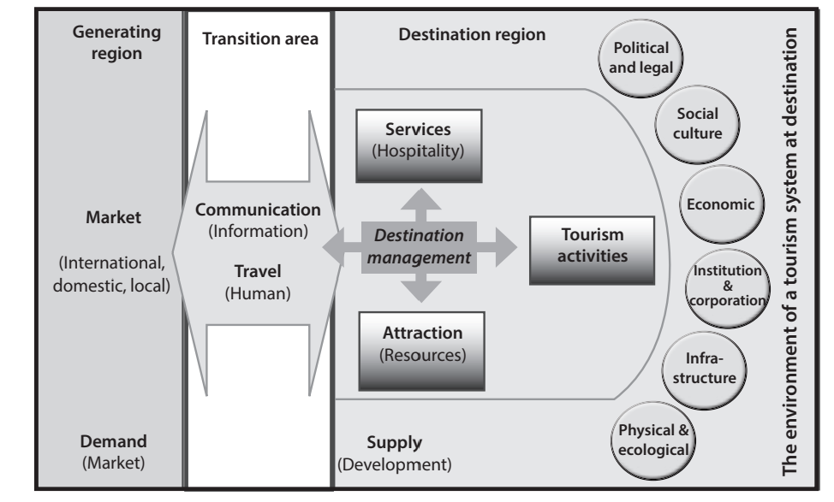

Tourism has its own system of suppliers & stakeholders.
A basic model of the tourism system, adapted from Gunn, 1994; Leiper, 1979; Mill & Morrison, 1998; Van Mai & Bosch, 2009; Weichard, 1992.

Slide 18
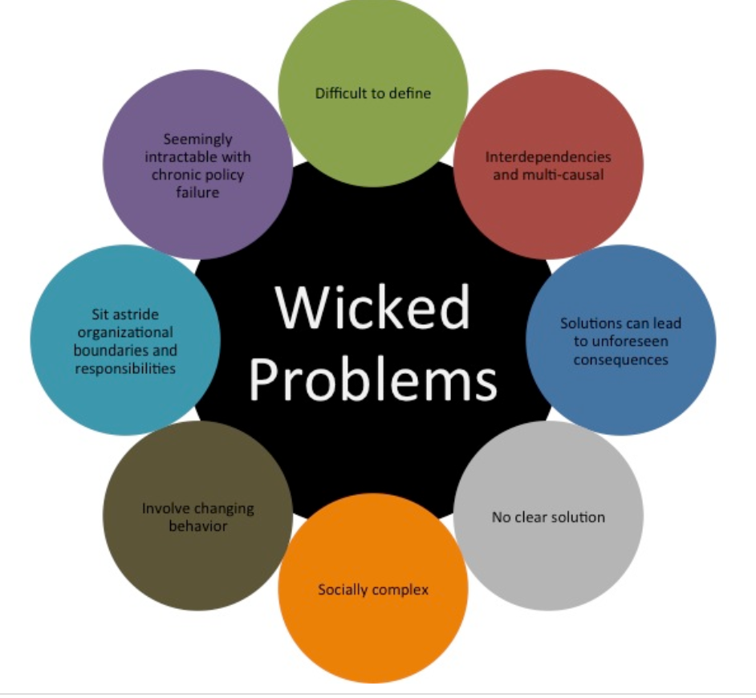
Sustainable tourism as a wicked problem?
One outcome of looking at tourism systems and sustainability is that they start to look like wicked problems.

Slide 19

Some things to think about
What does non-linear mean for the word “management”?
What about the tragedy of the commons in tourism… are most attractions private or public?
What types of interventions are most commonly used, from Meadows’ list?
What do the characteristics of a wicked problem tell us about the role of experts, the idea of generalisability, and the scale at which sustainability solutions are best implemented?

Slide 20
Next up…
Challenges to sustainability in tourism

